Slide 1
Illumination

Slide 2
Illumination: Lighting and Shading
Lighting equation
Approximates the real-world interaction
Light reflection
The color at each vertex is computed based on …
Light sources
Location and emission type
Surface reflection
Location, facing direction(normal vector), and material properties
Basic shading methods
Flat
Gouraud
Phong

Slide 3

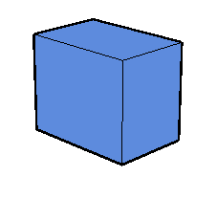
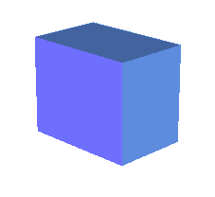
Illumination Components
Emission from light sources
Light scattering(=reflection) at surfaces
[Monotone coloring]
[Monotone with edge lines]
[Illumination]

Slide 4
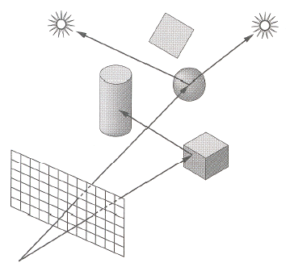
Shading Overview
Compute the radiance for each object
Determine where the lights come from
Figure out which pixels to fill
Paint the color for each pixel

Slide 5
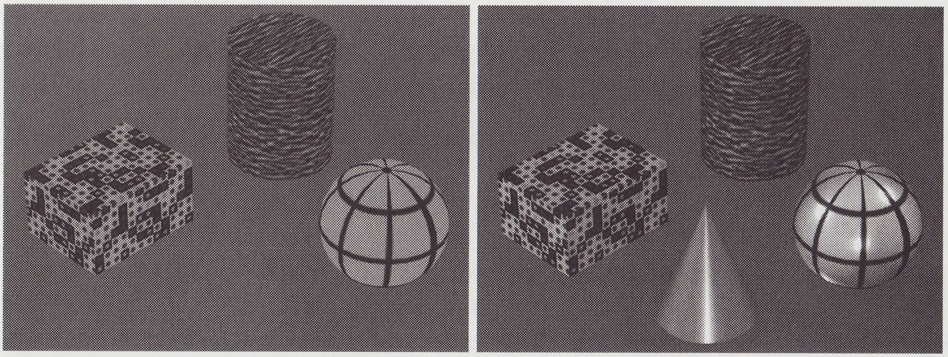
A Scene w/o & w/ Lighting

Slide 6
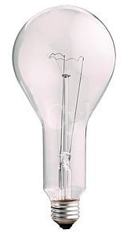

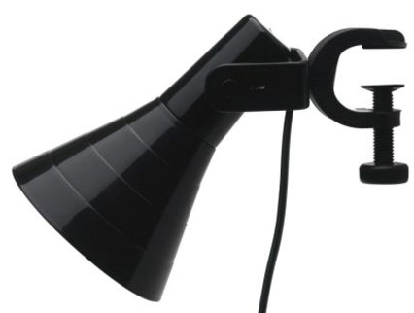
Light Source Model
Simple mathematical models
Point light
Directional light
Spotlight

Slide 7
Point Light Source
Omnidirectional point source
Intensity I
Position P(p_{x}, p_{y}, p_{z})
D₃
D₂
D₄
P(p_{x}, p_{y}, p_{z})
I
D₁
D₅

Slide 8
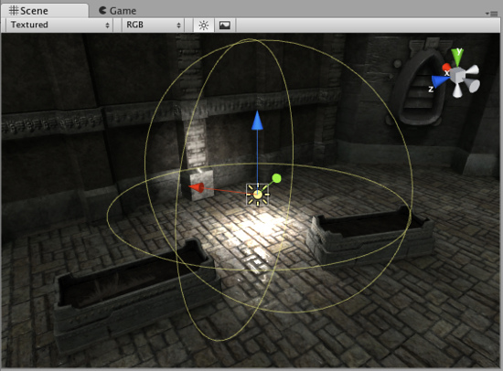
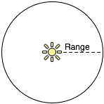
Point Light Example

Slide 9
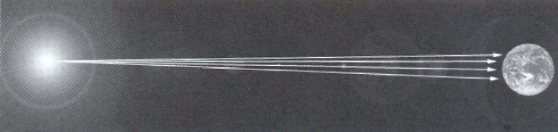

Directional Light Source
Point light source at infinity
Intensity I
Direction D(d_{x}, d_{y}, d_{z})
D(d_{x}, d_{y}, d_{z})
I

Slide 10
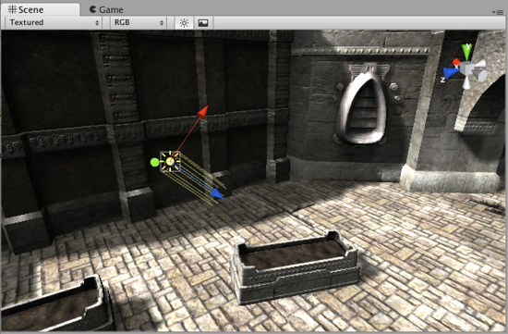
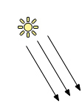
Directional Light Example

Slide 11
Spotlight Source
Point light source with direction
Intensity I
Position P(p_{x}, p_{y}, p_{z})
Direction D(d_{x}, d_{y}, d_{z})
Light vector L(l_{x}, l_{y}, l_{z})
To a surface point from the light source
In-between angle γ
Light concentrating factor n
I_{spot} = I x (cos γ)^{n} = I x (D·L)^{n}
P(p_{x}, p_{y}, p_{z})
I
γ
L(l_{x}, l_{y}, l_{z})
D(d_{x}, d_{y}, d_{z})

Slide 12
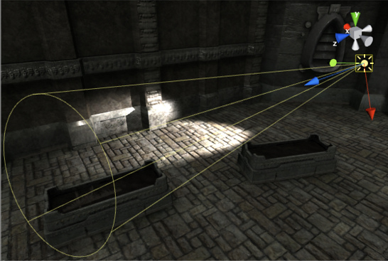
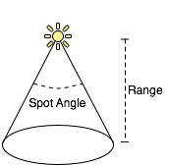
Spotlight Example

Slide 13
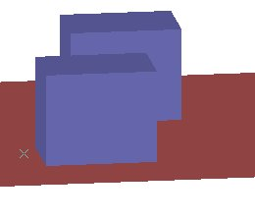
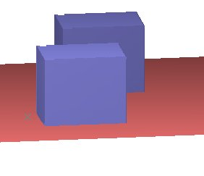
Attenuation of Light Intensity
Distance falloff for
Point light & spotlight
Types
None: constant intensity
Linear
Quadratic
I_{linear} = I_{L} / (a+bx)
I_{quadratic} = I_{L} / (a+bx+cx²)

Slide 14
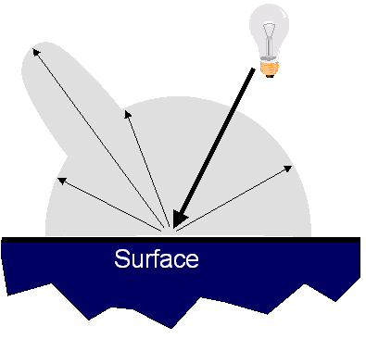
Reflectance Model
Simple analytic model
Emission
Ambient
Diffuse reflection
Specular reflection

Slide 15
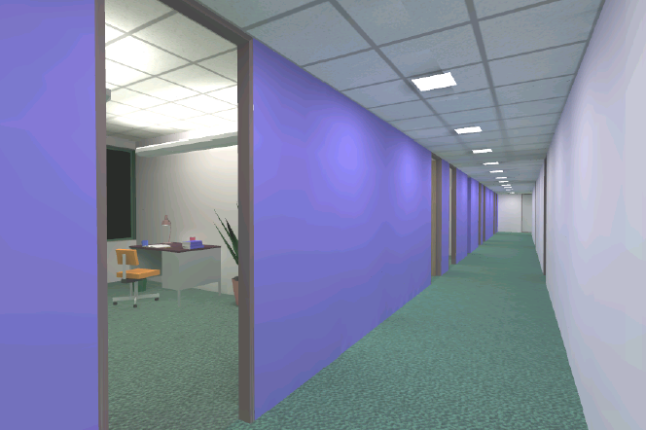
Emission & Ambient Light
Emission
Light emitting directly from surfaces
ex) light source
Ambient reflection
Compensated reflection of indirect illumination
Global illumination
Emission ≠ 0

Slide 16
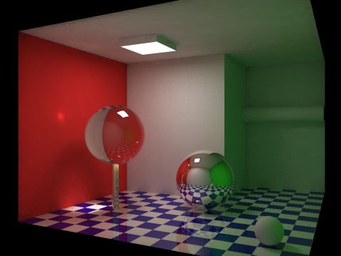
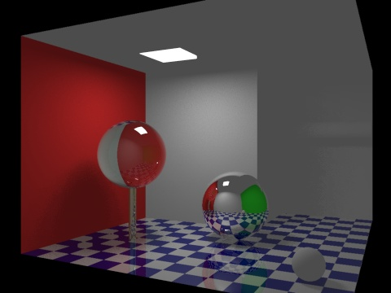
Global vs. Local Illumination
Includes indirect lighting or not

Slide 17
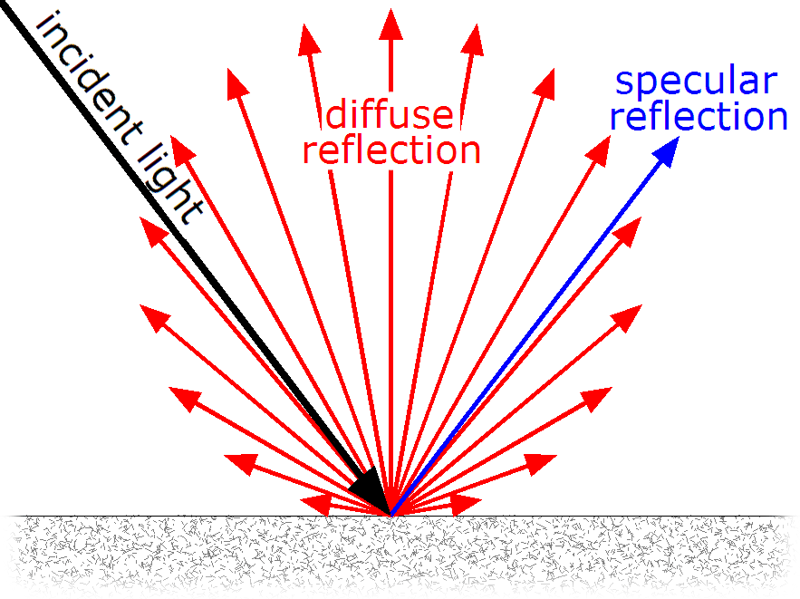
Diffuse & Specular Reflection Preview

Slide 18
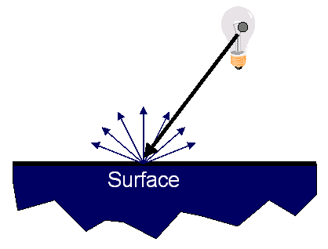
Pure Diffuse Reflection
Surface reflects equally in all directions
With equal intensity → view independent
I_{L}
[Pure diffuse reflection]

Slide 19
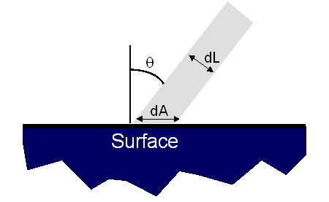
The Amount of Diffuse Reflection
: componentwise multiplication
Depends on the angle of incident light
Maximum at the head-on light (θ = 0)
N
L
K_{D} : Diffuse Reflectance Factor

Slide 20
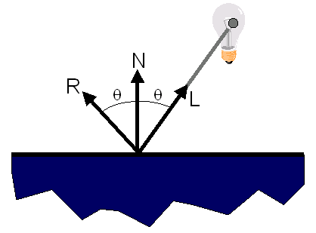
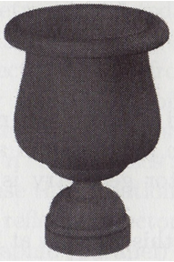
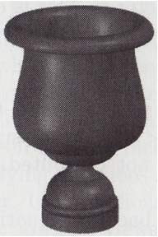
Specular Reflection
Strongest reflection near the mirror angle
Makes a surface look shiny by creating highlights
ex) mirrors, metals
Highlight effect
Helps the viewer understand the surface’s curvature
Shows the directions & locations of the light sources

Slide 21
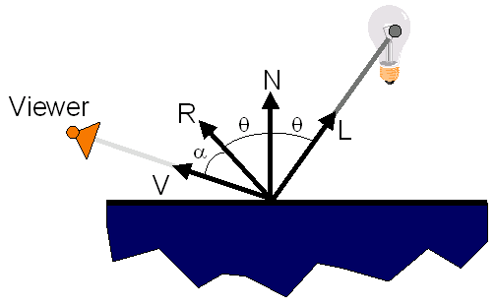
The Amount of Specular Reflection
Depends on the angle α to a viewer
(cos α)^{n} = (V·R)^{n}
n : shininess factor
cf.) light concentrating factor
K_{S} : Specular Reflectance Factor

Slide 22
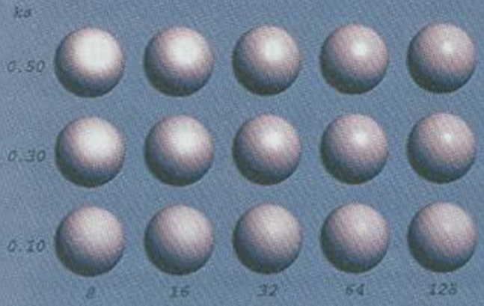
The Effects of Shininess Factor n
Ambient
n

Slide 23
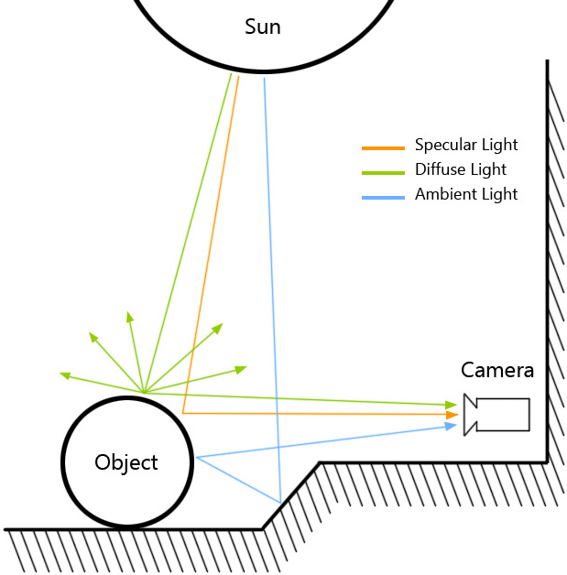
Ambient / Diffuse / Specular Review

Slide 24
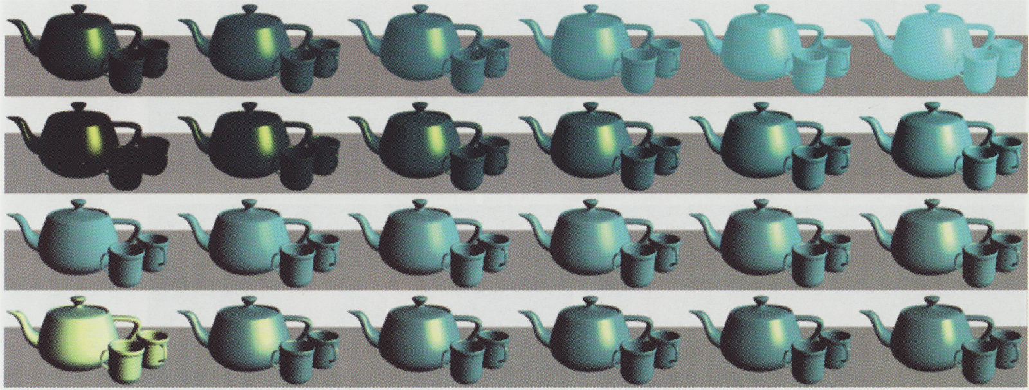
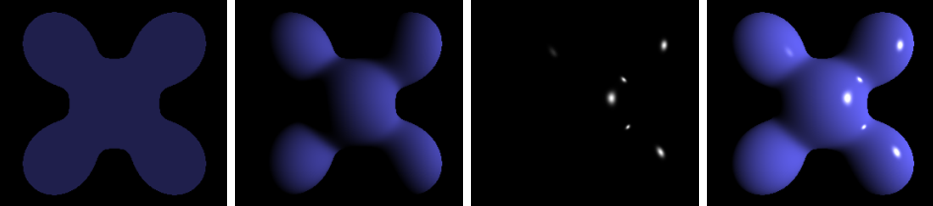
Reflection Components Summary
Ambient
Diffuse
Specular
Shininess
Ambient + Diffuse + Specular = Complex reflection

Slide 25
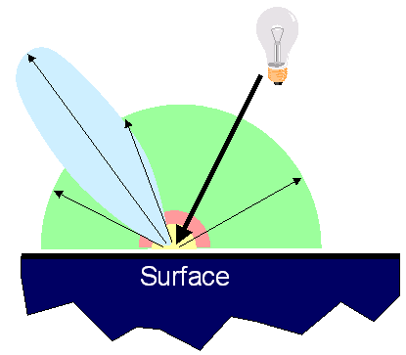
Reflectance Model Revisited
Simple analytic model
Emission
Ambient
Diffuse reflection
Specular reflection

Slide 26
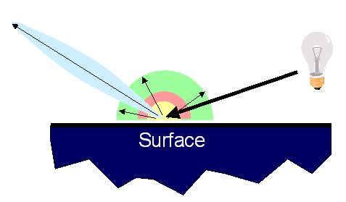
Reflectance Model Revisited
Simple analytic model
Emission
Ambient
Diffuse reflection
Specular reflection
Not affected by the position of the light source
Affected by the position of the light source

Slide 27
Light Intensity Function
I_{E} : emitted intensity for light sources
K_{A}, K_{D}, K_{S} : ambient / diffuse / specular reflection factor
I_{AL} : ambient light intensity
N : unit normal vector
L : unit light vector
I_{L} : the intensity of the light source
V : unit viewing direction vector
R : specular reflection vector
n : shininess factor

Slide 28
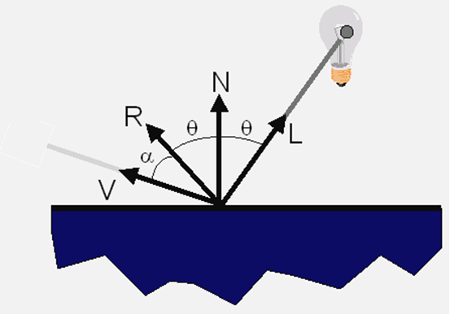
Surface Illumination Calculation (1/2)
Single light source

Slide 29
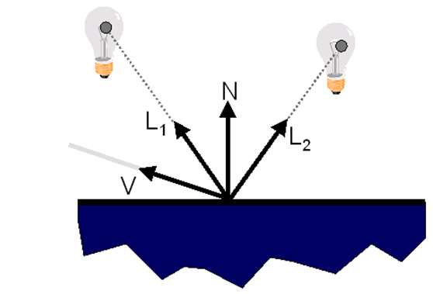
Surface Illumination Calculation (2/2)
Multiple light sources

Slide 30

What color is a mirror?

